Slide 1
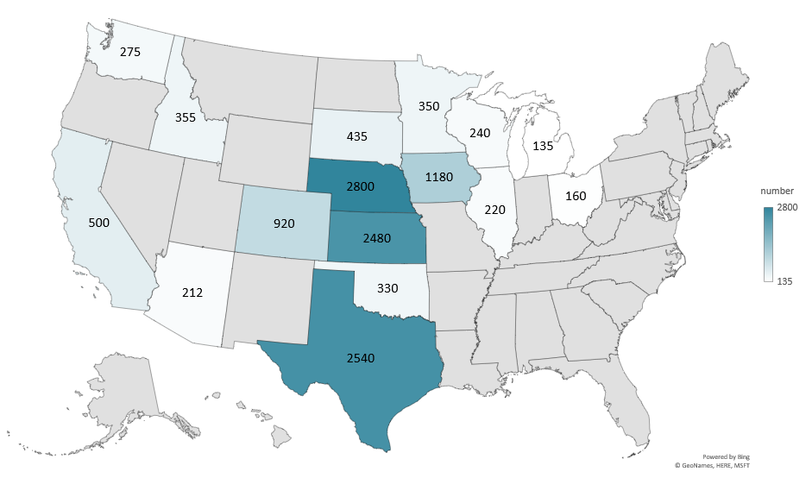
CATTLE ON FEED JANUARY 1, 2026
(1000 Head)
Livestock Marketing Information Center
Data Source: USDA-NASS

Slide 2
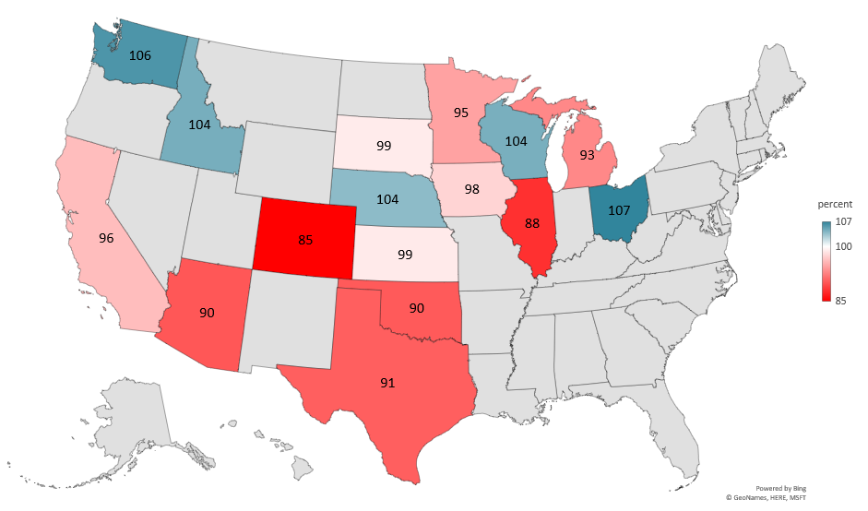
CATTLE ON FEED JANUARY 1, 2026
AS A % OF 2025
Livestock Marketing Information Center
Data Source: USDA-NASS
Note: 2024 Other States calculated by LMIC

Slide 3
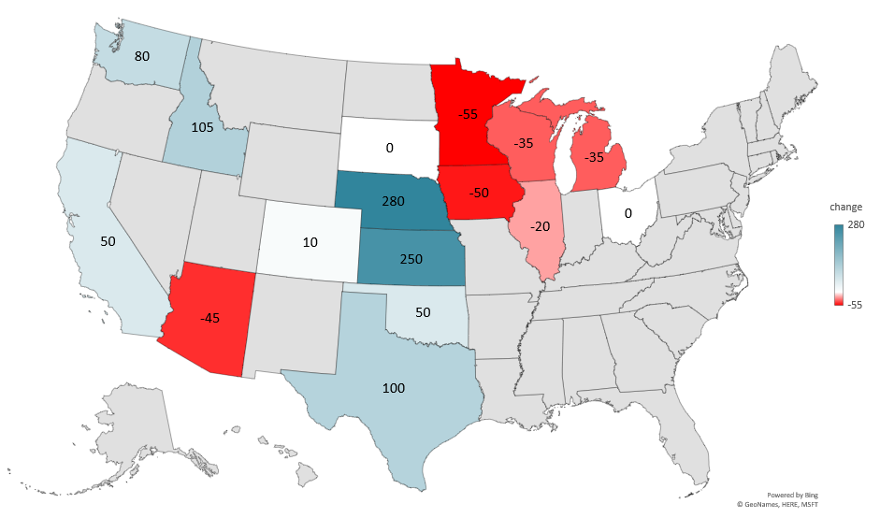
CHANGE IN CATTLE ON FEED 2016-2026
(1000 Head)
Livestock Marketing Information Center
Data Source: USDA-NASS
Note: 2015 Other States calculated by LMIC

Slide 4
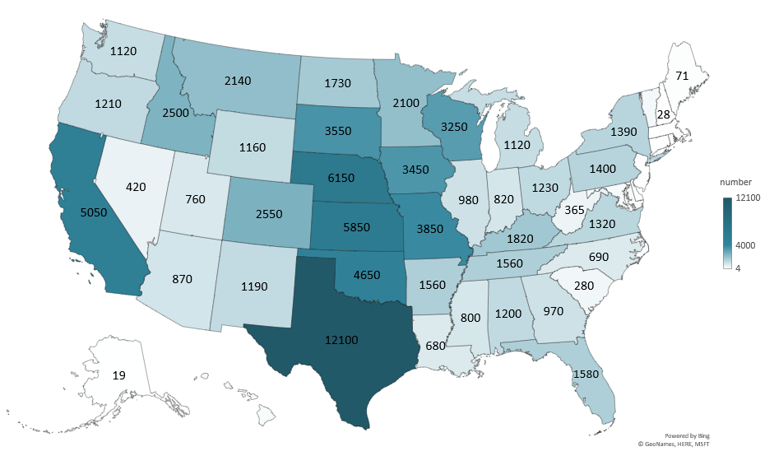
TOTAL CATTLE JANUARY 1, 2026
(1000 Head)
Livestock Marketing Information Center
Data Source: USDA-NASS

Slide 5
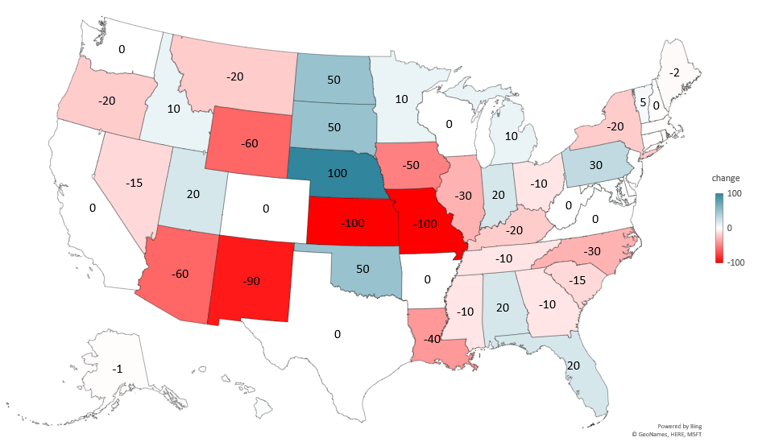
CHANGE IN TOTAL CATTLE 2025-2026
(1000 Head)
Livestock Marketing Information Center
Data Source: USDA-NASS

Slide 6
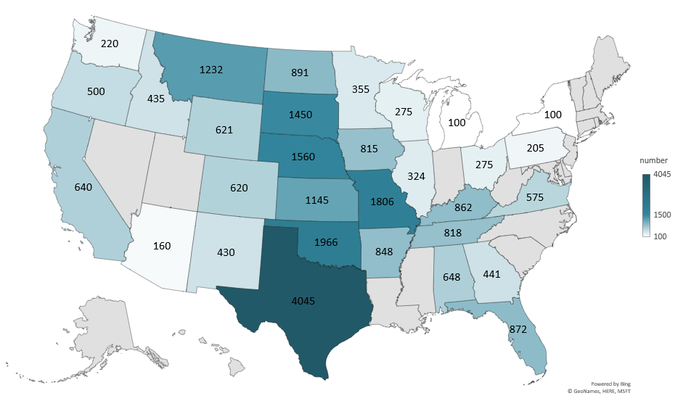
BEEF COWS THAT CALVED JANUARY 1, 2026
(1000 Head)
Livestock Marketing Information Center
Data Source: USDA-NASS

Slide 7
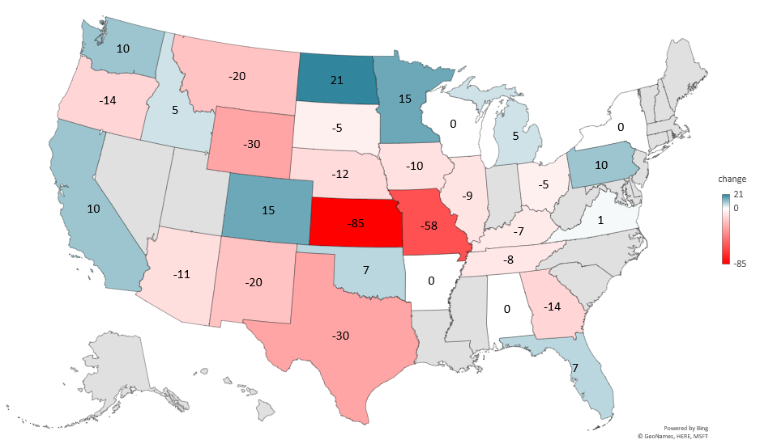
CHANGE IN BEEF COWS 2025 TO 2026
(1000 Head)
Livestock Marketing Information Center
Data Source: USDA-NASS

Slide 8
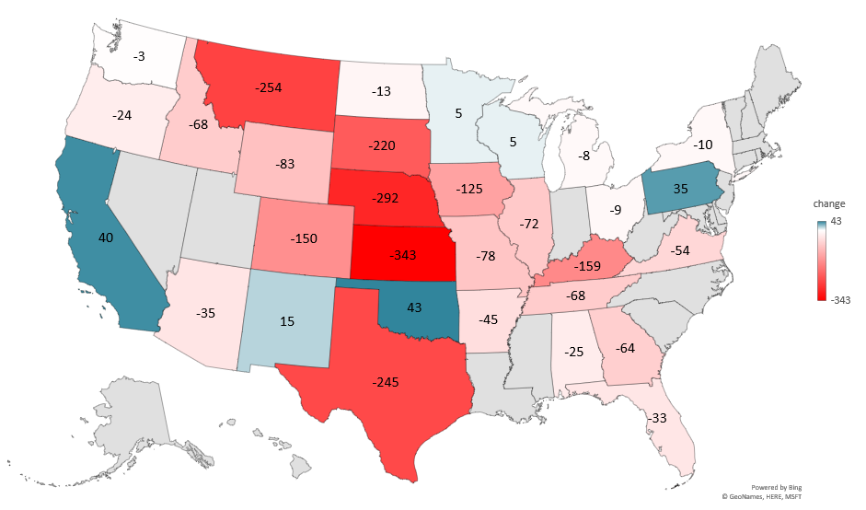
CHANGE IN BEEF COWS 2016 TO 2026
(1000 Head)
Livestock Marketing Information Center
Data Source: USDA-NASS
Note: 2016 Other States calculated by LMIC

