Slide 1
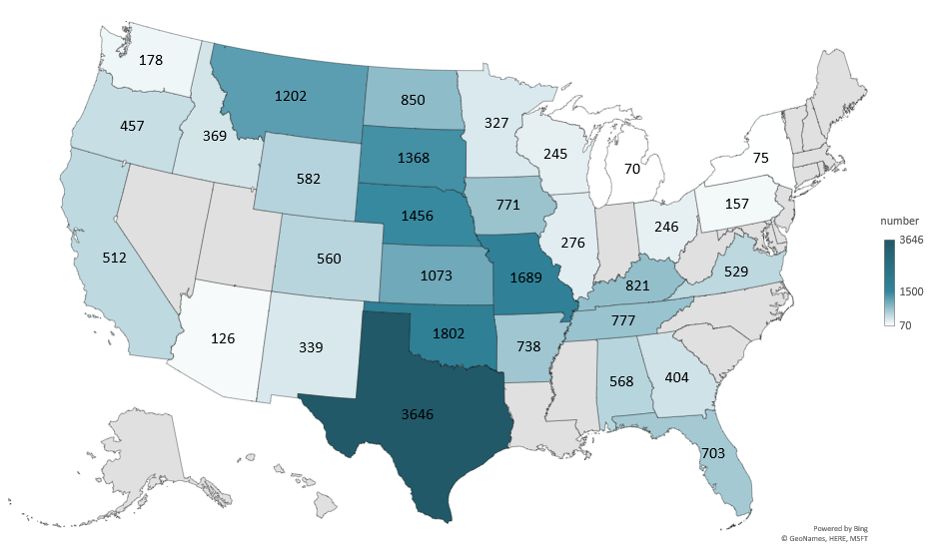
CALCULATED BEEF CALF CROP 2025 (1000 Head)
Livestock Marketing Information Center
Data Source: USDA-NASS

Slide 2
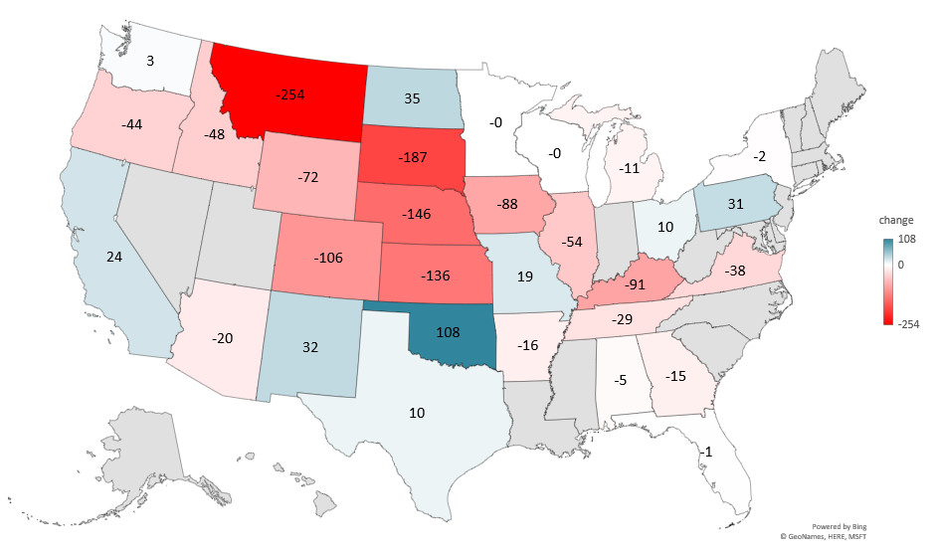
CHANGE IN BEEF CALF CROP 2015 - 2025 (1000 Head)
Livestock Marketing Information Center
Data Source: USDA-NASS

Slide 3
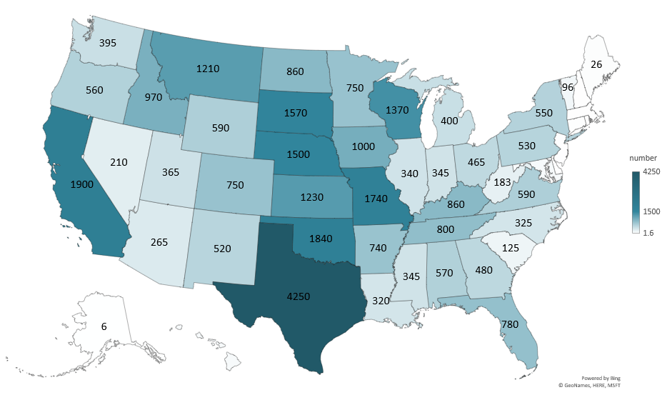
TOTAL CALF CROP 2025 (1000 Head)
Livestock Marketing Information Center
Data Source: USDA-NASS

Slide 4
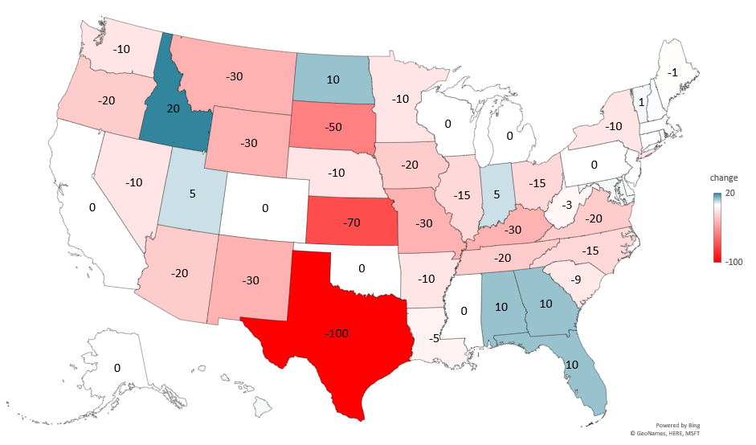
CHANGE IN TOTAL CALF CROP 2024 - 2025 (1000 Head)
Livestock Marketing Information Center
Data Source: USDA-NASS

Slide 5
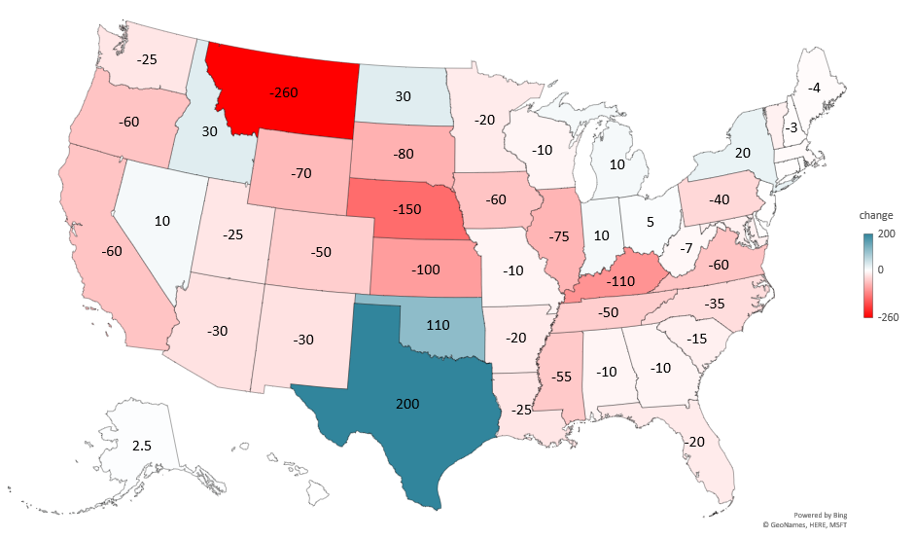
CHANGE IN TOTAL CALF CROP 2015 - 2025 (1000 Head)
Livestock Marketing Information Center
Data Source: USDA-NASS

Slide 6
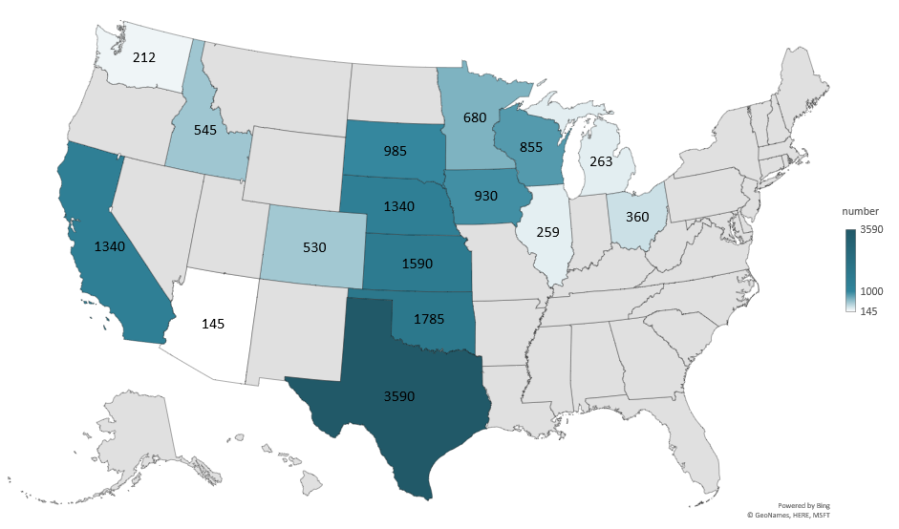
TOTAL FEEDER CATTLE SUPPLY OUTSIDE FEELOTS JANUARY 1, 2026 (1000 Head)
Livestock Marketing Information Center
Data Source: USDA-NASS
Note: Other States calculated by LMIC

Slide 7
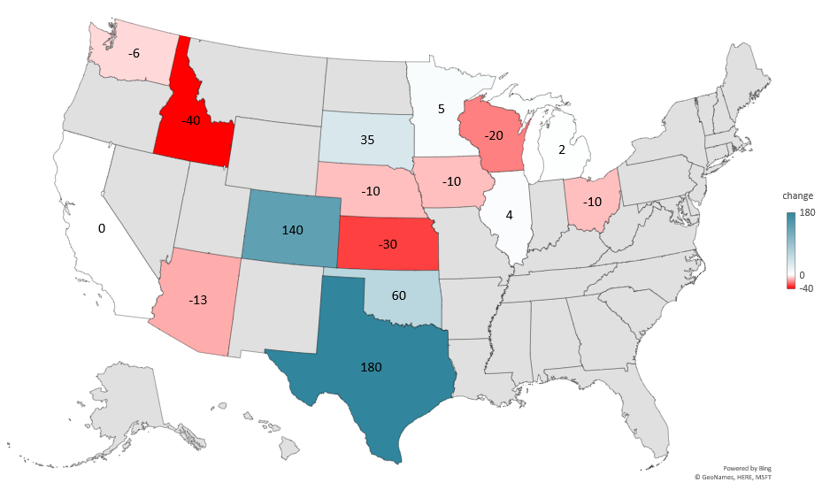
CHANGE IN FEEDER CATTLE SUPPLY OUTSIDE FEELOTS JANUARY 1, 2025 TO 2026 (1000 Head)
Livestock Marketing Information Center
Data Source: USDA-NASS
Note: Other States calculated by LMIC

