Slide 1
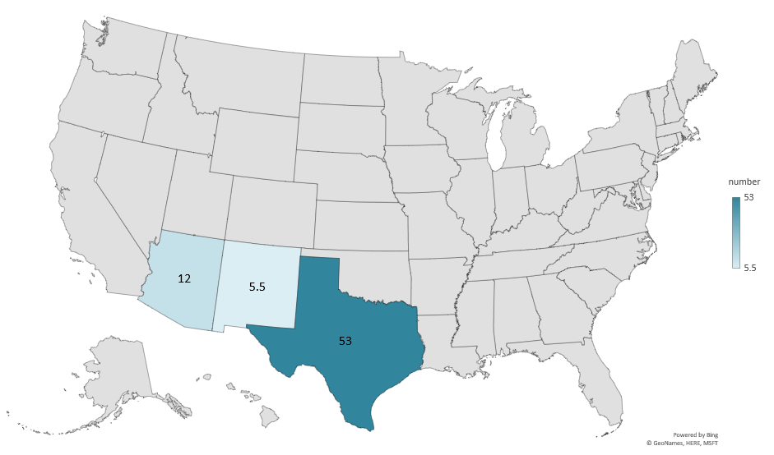
ANGORA GOAT INVENTORY 2026 (1000 Head)
Livestock Marketing Information Center
Data Source: USDA-NASS

Slide 2
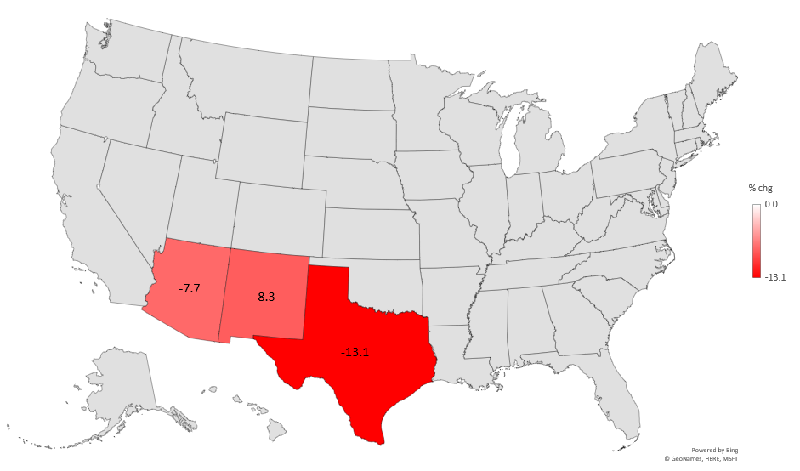
PERCENT CHANGE ANGORA GOATS INVENTORY (2025-2026)
Livestock Marketing Information Center
Data Source: USDA-NASS

Slide 3
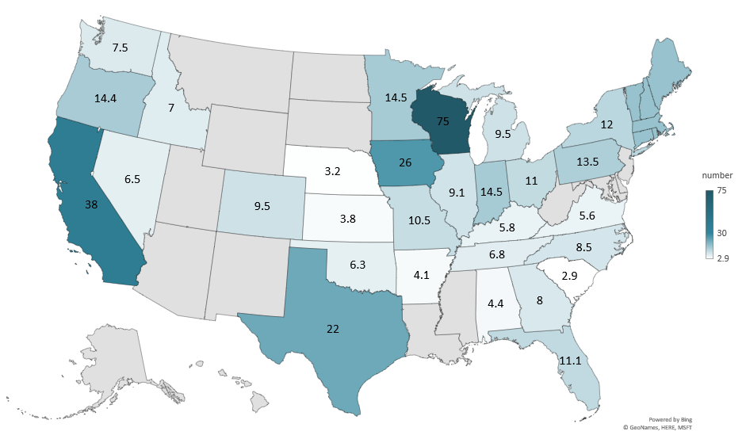
DAIRY GOAT INVENTORY 2026 (1000 Head)
Livestock Marketing Information Center
Data Source: USDA-NASS

Slide 4
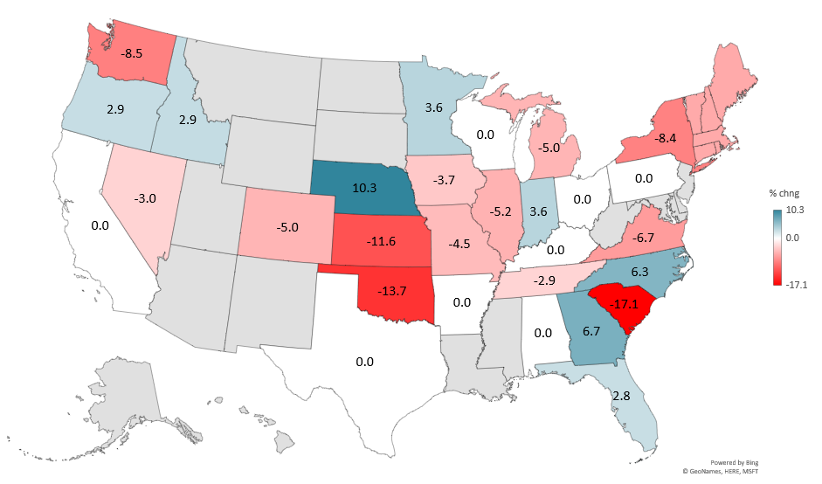
PERCENT CHANGE DAIRY GOATS INVENTORY (2025-2026)
Livestock Marketing Information Center
Data Source: USDA-NASS

Slide 5
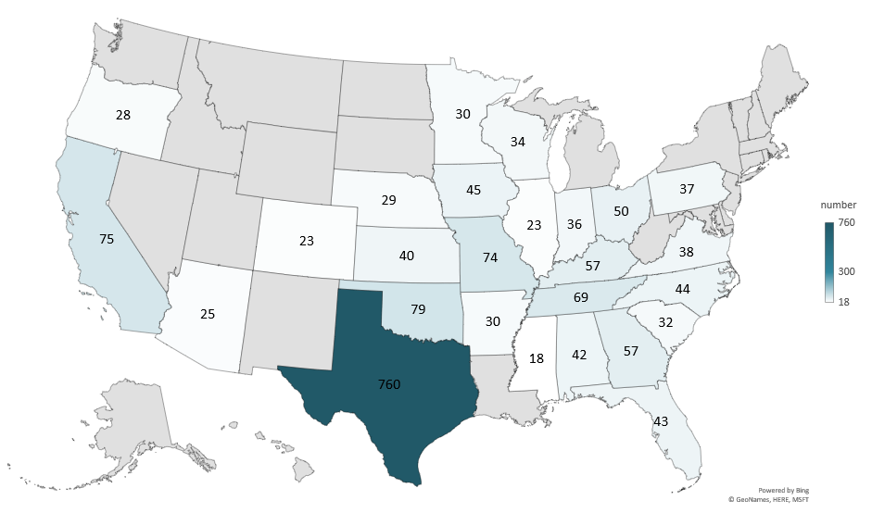
MEAT GOAT INVENTORY 2026 (1000 Head)
Livestock Marketing Information Center
Data Source: USDA-NASS

Slide 6
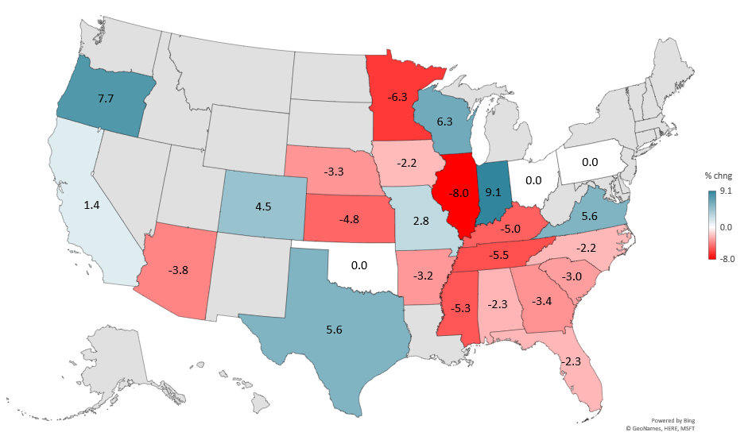
PERCENT CHANGE MEAT GOATS INVENTORY (2025-2026)
Livestock Marketing Information Center
Data Source: USDA-NASS

