Slide 1

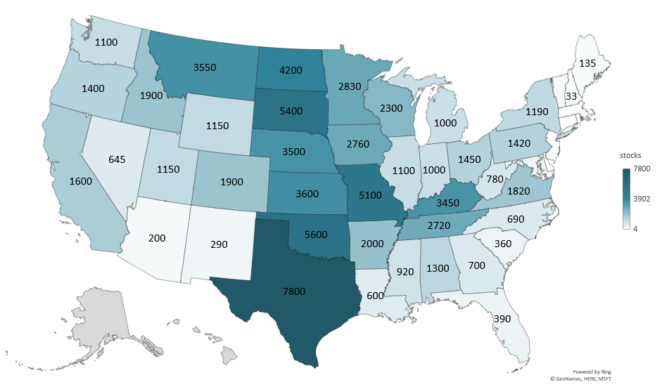
2025 DECEMBER 1 HAY STOCKS (1000 Tons)
Livestock Marketing Information Center
Data Source: USDA-NASS

Slide 2
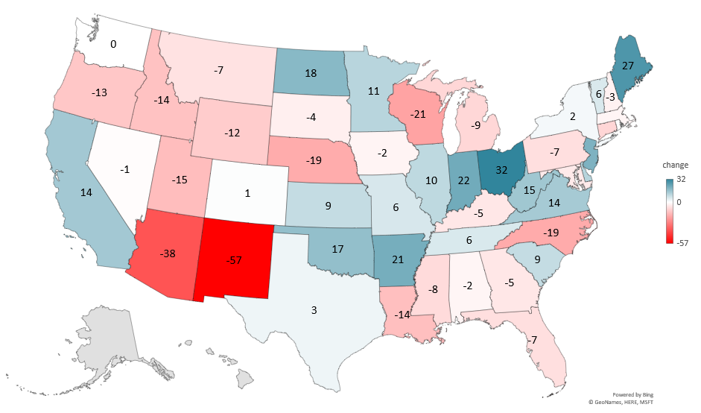
PERCENT CHANGE DECEMBER 1 HAY STOCKS (2024-2025)
Livestock Marketing Information Center
Data Source: USDA-NASS

Slide 3
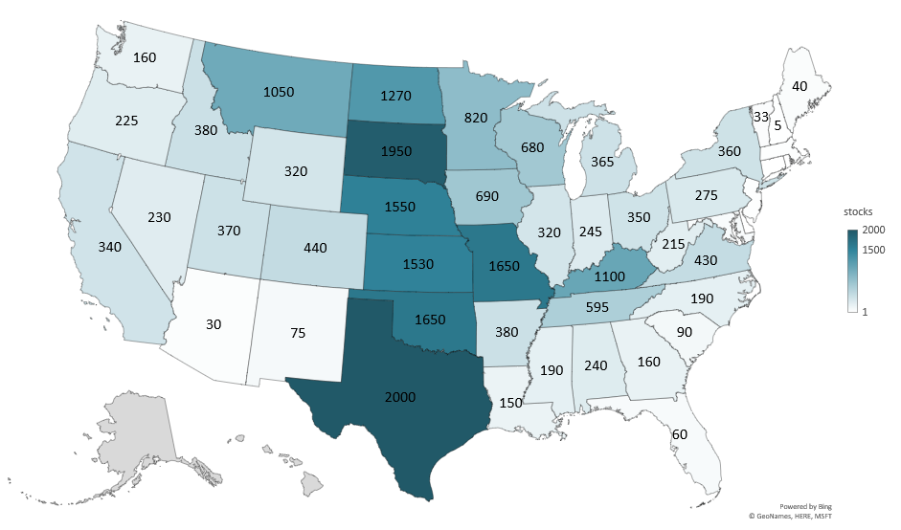
2025 MAY 1 HAY STOCKS (1000 Tons)
Livestock Marketing Information Center
Data Source: USDA-NASS

Slide 4
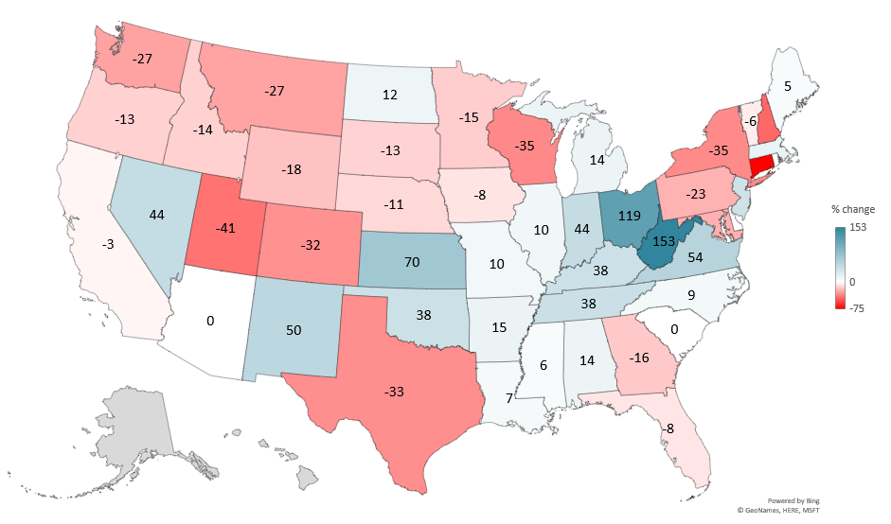
PERCENT CHANGE MAY 1 HAY STOCKS (2024-2025)
Livestock Marketing Information Center
Data Source: USDA-NASS

Slide 5
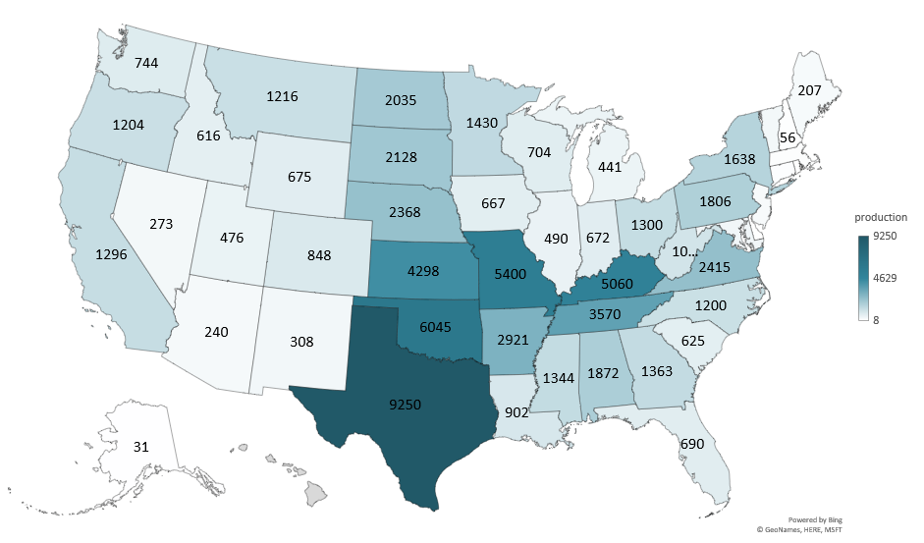
OTHER HAY PRODUCTION 2025 (1000 Tons)
Livestock Marketing Information Center
Data Source: USDA-NASS

Slide 6
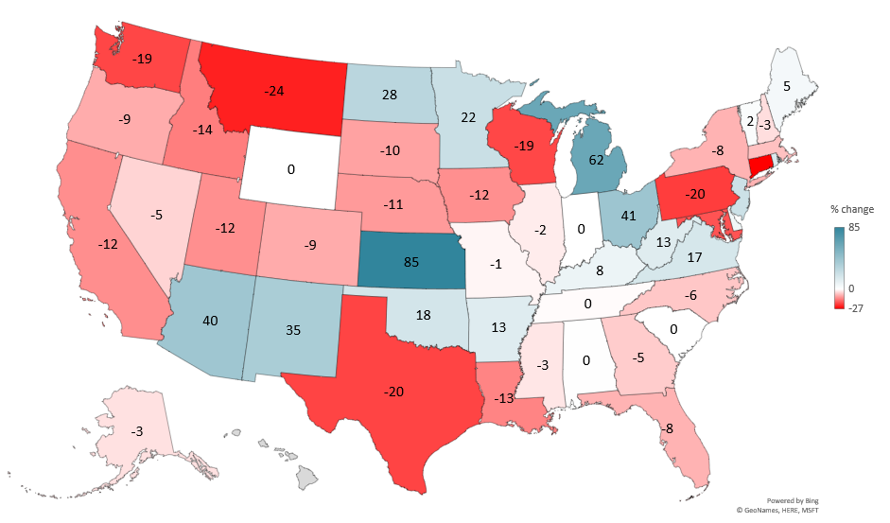
PERCENT CHANGE OTHER HAY PRODUCTION (2024-2025)
Livestock Marketing Information Center
Data Source: USDA-NASS

Slide 7
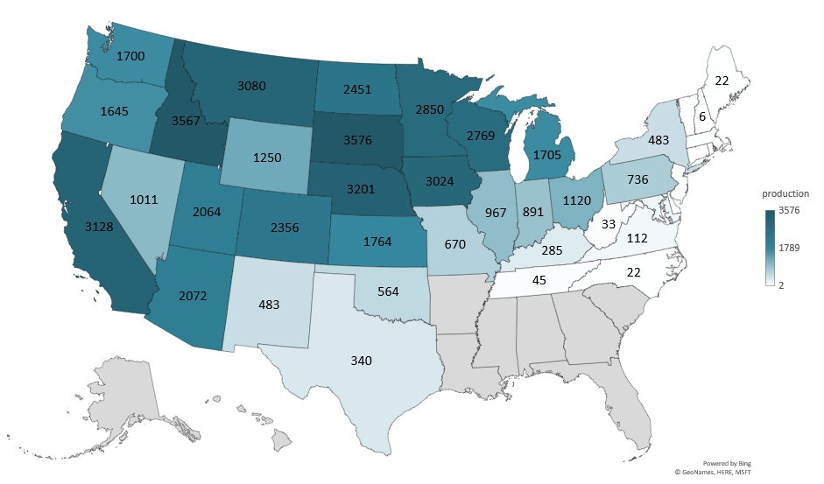
ALFALFA HAY PRODUCTION 2025 (1000 Tons)
Livestock Marketing Information Center
Data Source: USDA-NASS

Slide 8
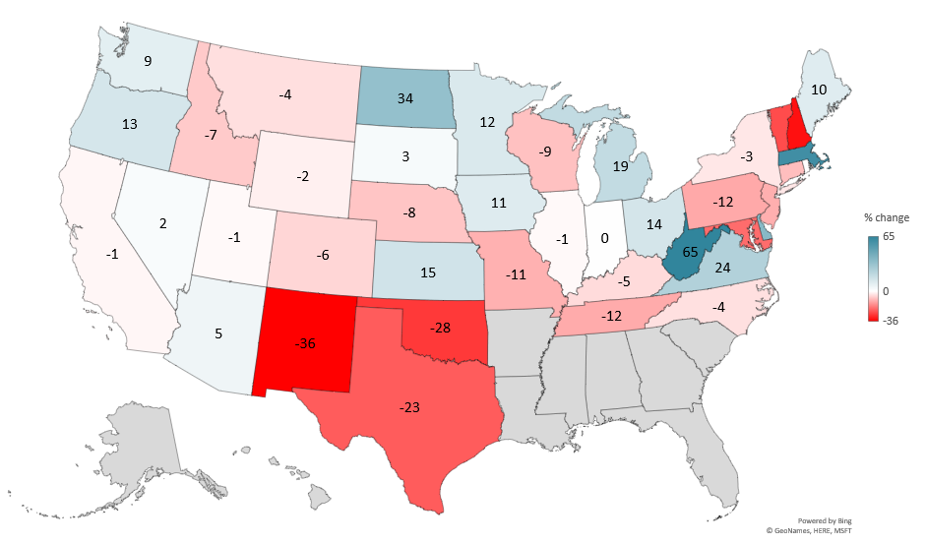
PERCENT CHANGE ALFALFA HAY PRODUCTION (2024-2025)
Livestock Marketing Information Center
Data Source: USDA-NASS

