Slide 1
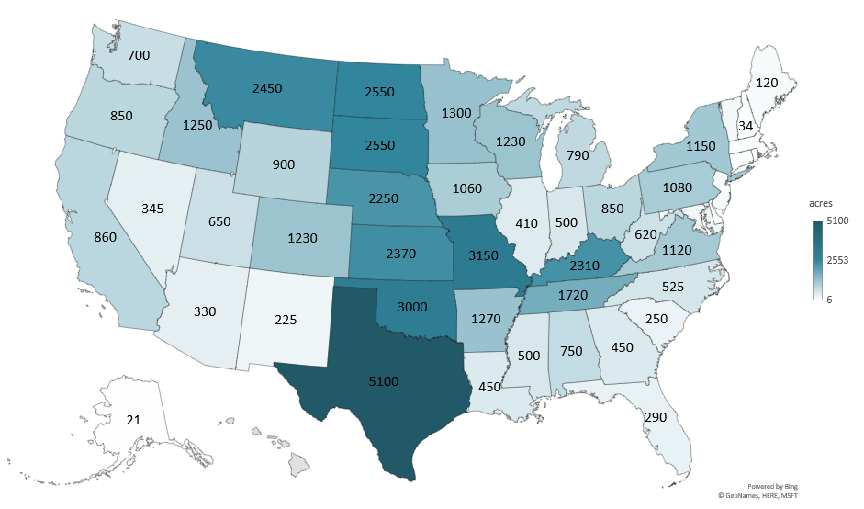
2025 ALL HAY ACRES
(1000 Acres)
Livestock Marketing Information Center
Data Source: USDA-NASS

Slide 2
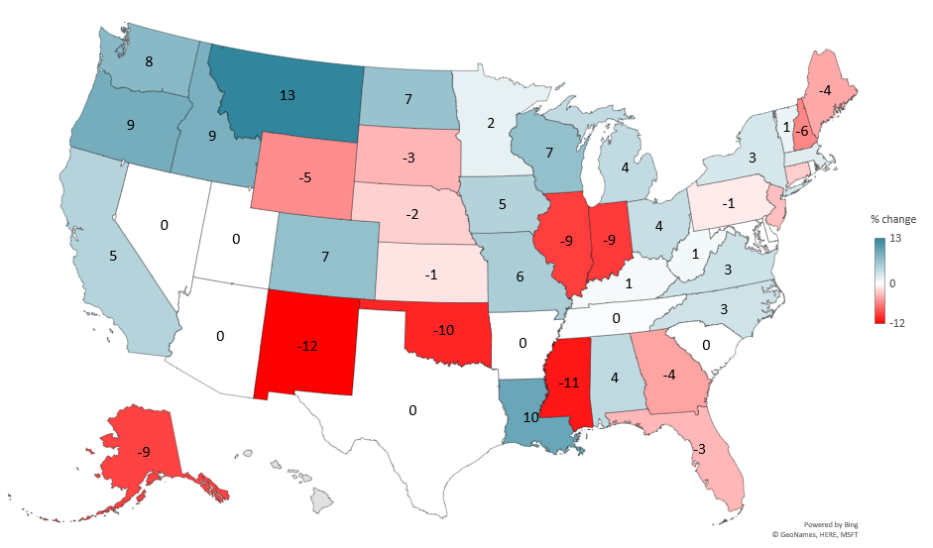
PERCENT CHANGE ALL HAY ACRES
(2024-2025)
Livestock Marketing Information Center
Data Source: USDA-NASS

Slide 3
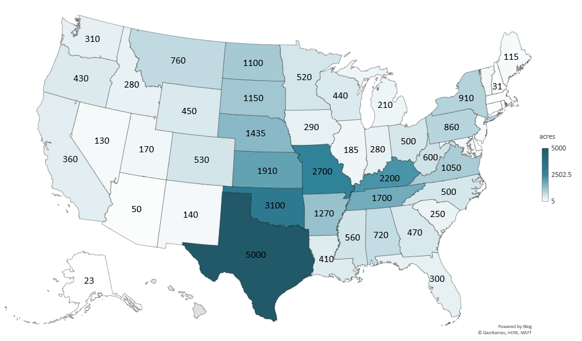
2025 OTHER HAY ACRES
(1000 Acres)
Livestock Marketing Information Center
Data Source: USDA-NASS

Slide 4
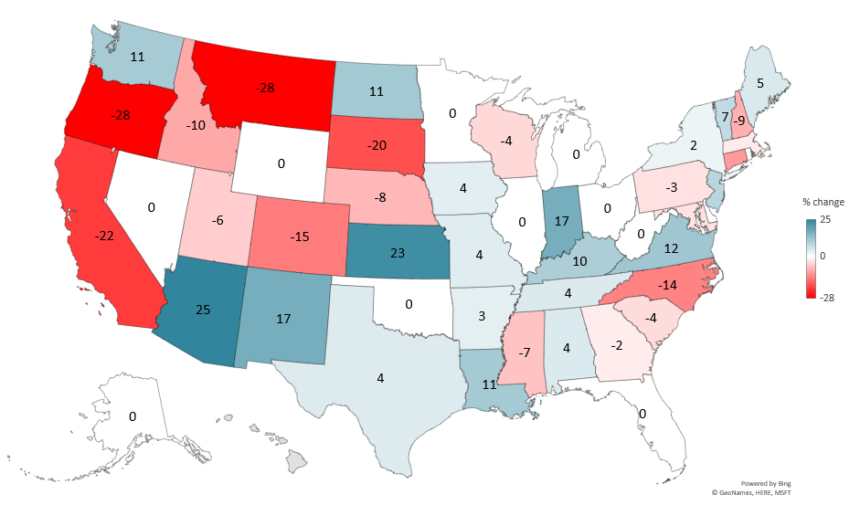
PERCENT CHANGE OTHER HAY ACRES
(2024-2025)
Livestock Marketing Information Center
Data Source: USDA-NASS

Slide 5
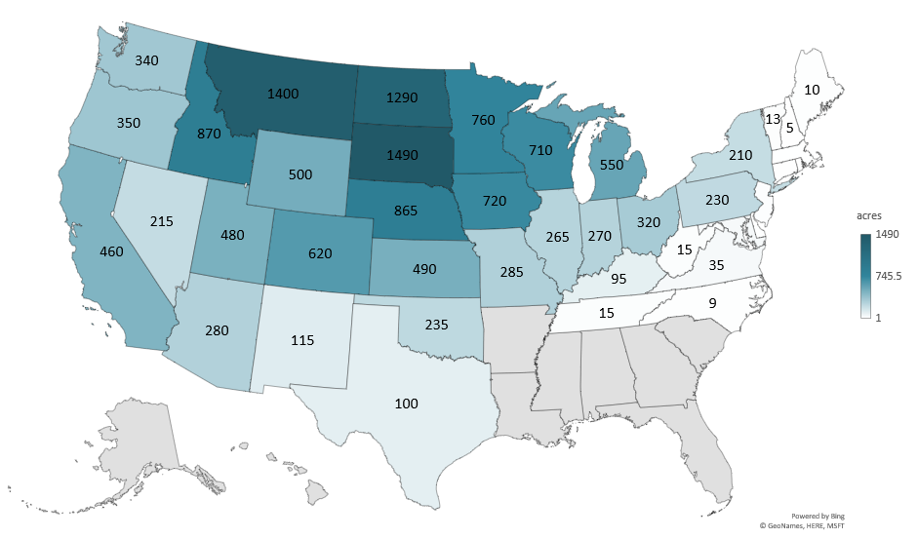
2025 ALFALFA HAY ACRES
(1000 Acres)
Livestock Marketing Information Center
Data Source: USDA-NASS

Slide 6
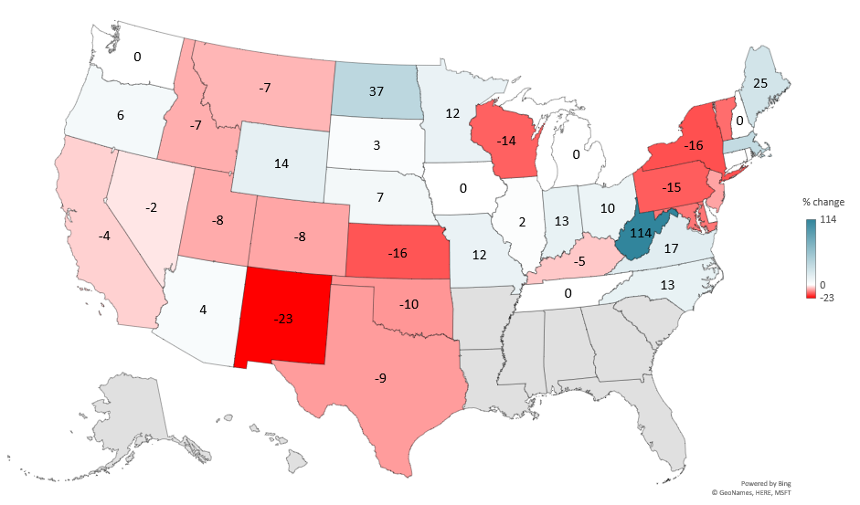
PERCENT CHANGE ALFALFA HAY ACRES
(2024-2025)
Livestock Marketing Information Center
Data Source: USDA-NASS

Slide 7
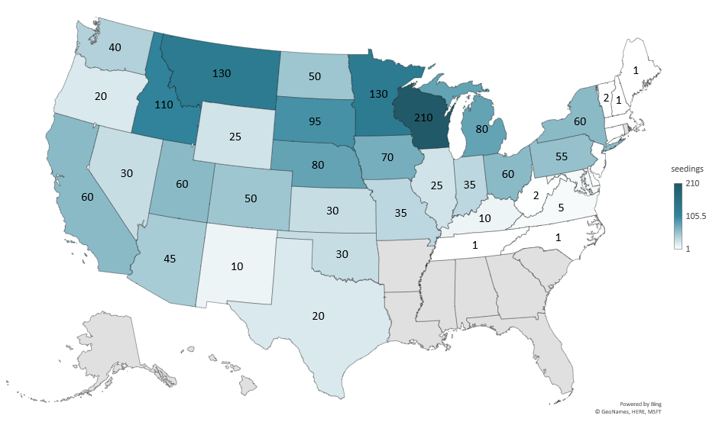
2025 NEW SEEDINGS ACRES
(1000 Acres)
Livestock Marketing Information Center
Data Source: USDA-NASS

Slide 8
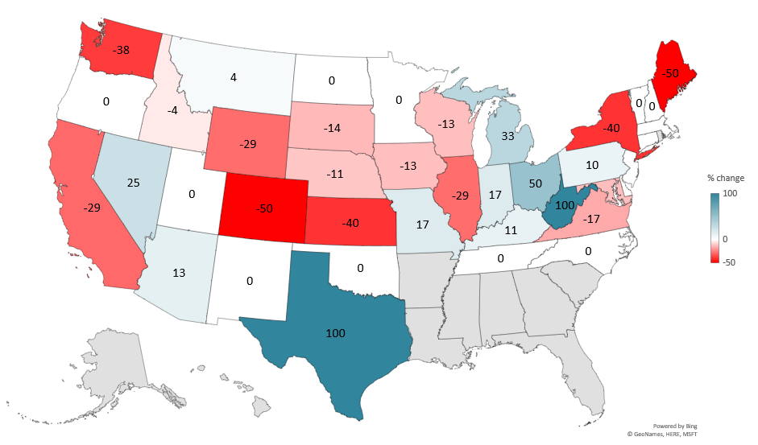
PERCENT CHANGE NEW SEEDINGS ACRES
(2024-2025)
Livestock Marketing Information Center
Data Source: USDA-NASS

