Slide 1
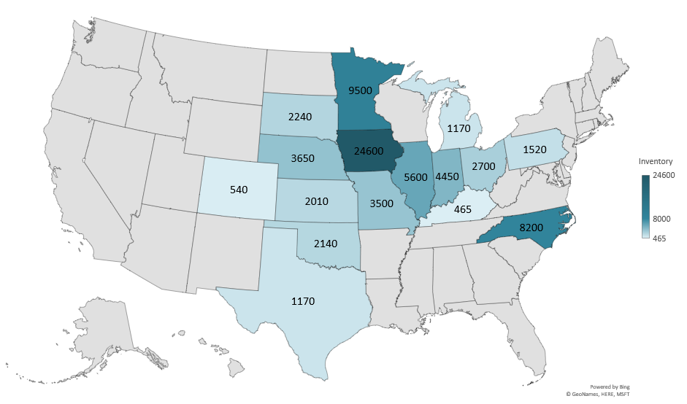
DECEMBER 1 TOTAL HOGS AND PIGS 2024
(1000 Head)
Livestock Marketing Information Center
Data Source: USDA-NASS

Slide 2
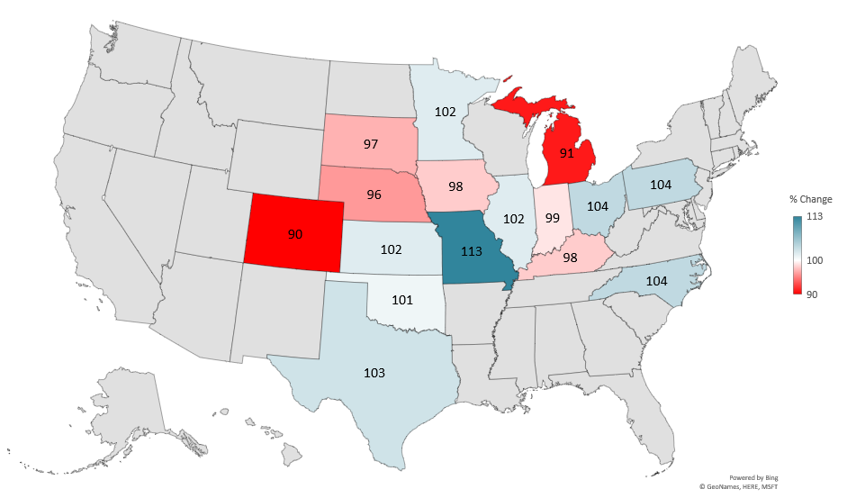
DECEMBER 1 TOTAL HOGS AND PIGS
2024 AS PERCENT OF 2023
Note: 2023 Other States calculated by LMIC
Livestock Marketing Information Center
Data Source: USDA-NASS

Slide 3
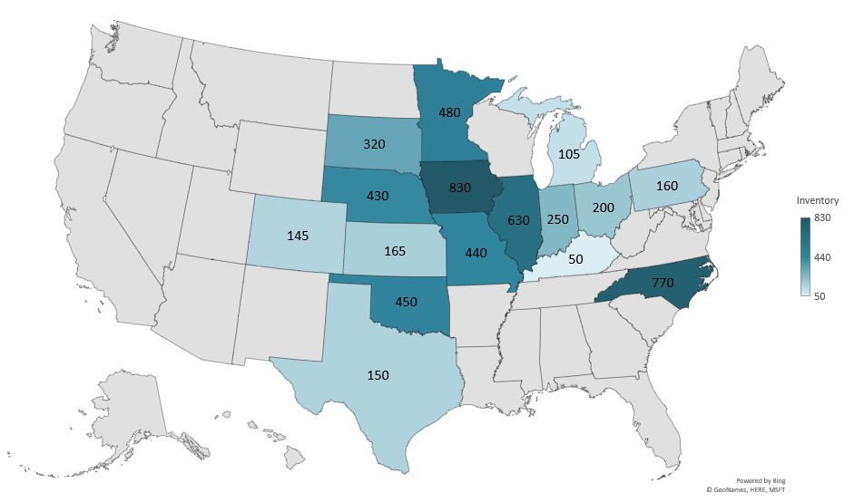
DECEMBER 1 BREEDING HOGS AND PIGS 2024
(1000 Head)
Livestock Marketing Information Center
Data Source: USDA-NASS

Slide 4
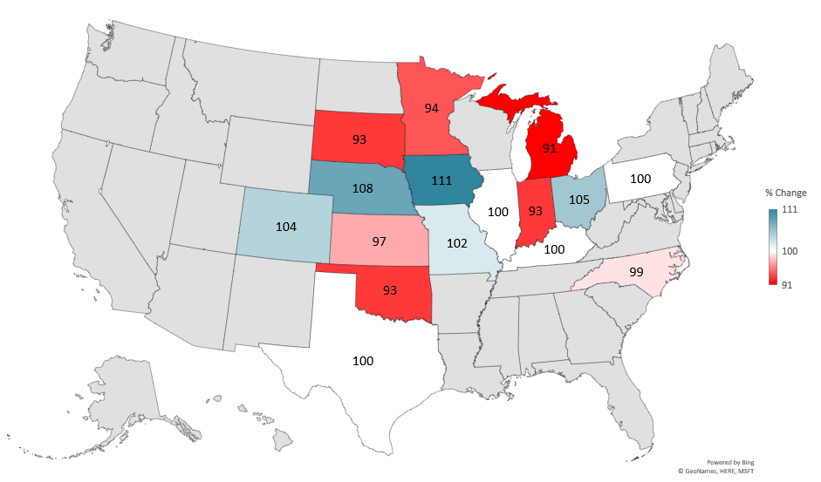
DECEMBER 1 BREEDING HOGS AND PIGS
2024 AS PERCENT OF 2023
Note: 2023 Other States calculated by LMIC
Livestock Marketing Information Center
Data Source: USDA-NASS

Slide 5
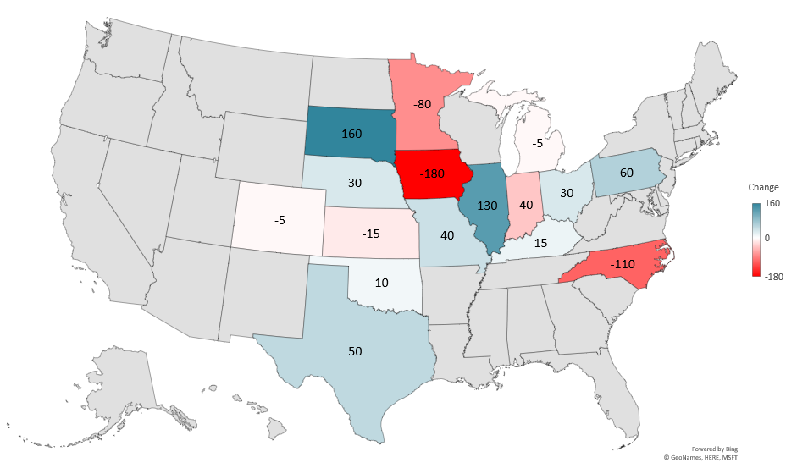
DECEMBER 1 BREEDING HOGS AND PIGS
CHANGE 2014 - 2024
(1000 Head)
Livestock Marketing Information Center
Data Source: USDA-NASS

Slide 6
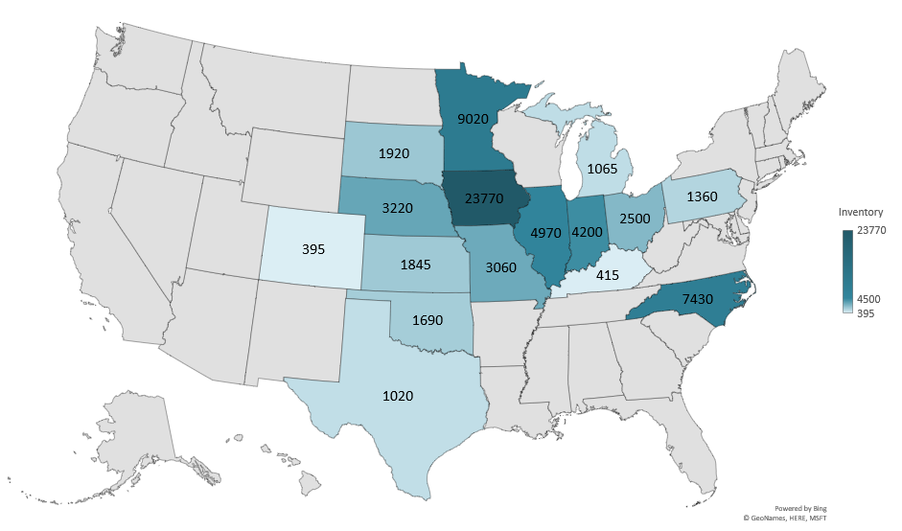
DECEMBER 1 MARKET HOGS AND PIGS 2024
(1000 Head)
Livestock Marketing Information Center
Data Source: USDA-NASS

Slide 7
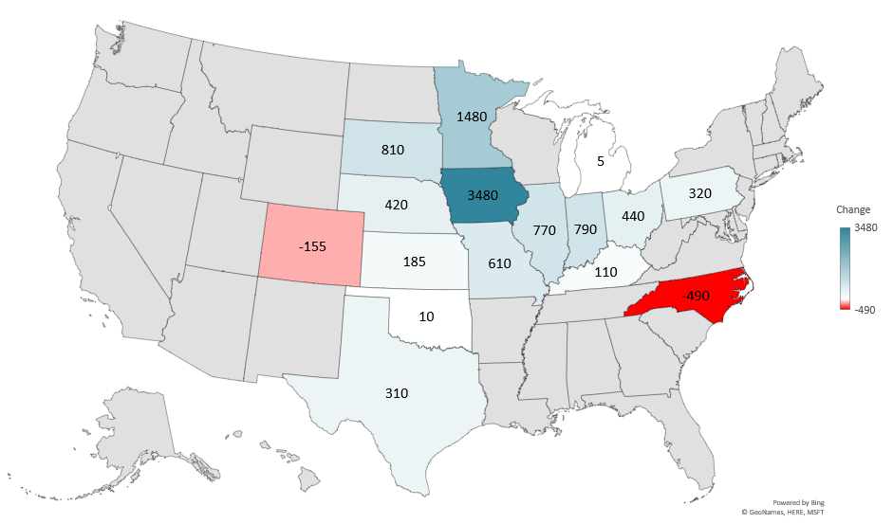
DECEMBER 1 MARKET HOGS AND PIGS
CHANGE 2014 - 2024
(1000 Head)
Livestock Marketing Information Center
Data Source: USDA-NASS

Slide 8
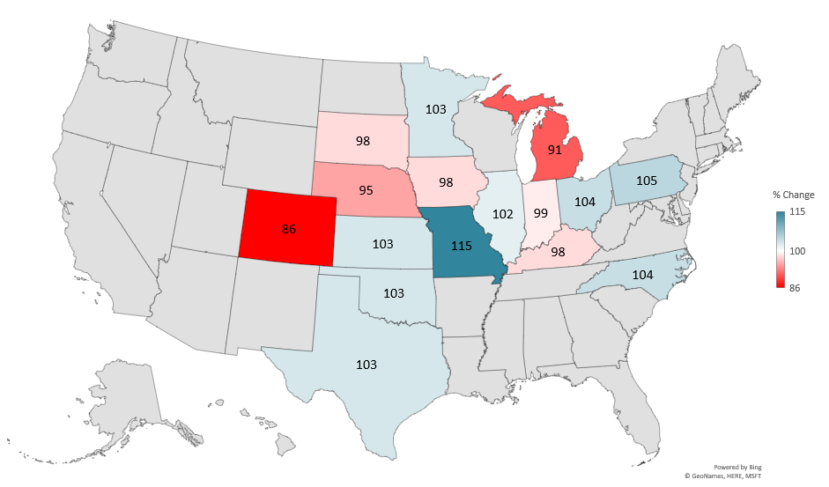
DECEMBER 1 MARKET HOGS AND PIGS
2024 AS PERCENT OF 2023
Note: 2023 Other States calculated by LMIC
Livestock Marketing Information Center
Data Source: USDA-NASS

