Slide 1
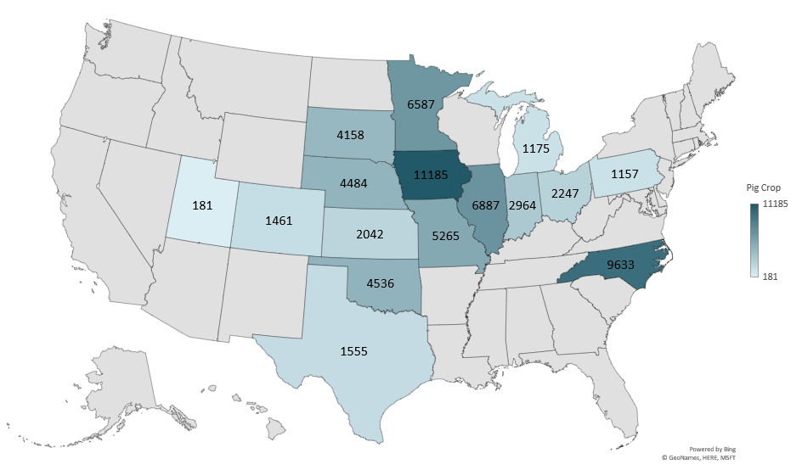
JUNE – NOVEMBER 2024 PIG CROP
(1000 Head)
Livestock Marketing Information Center
Data Source: USDA-NASS

Slide 2
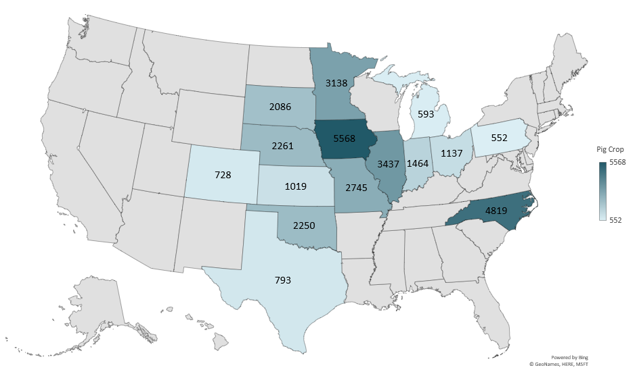
SEPTEMBER – NOVEMBER 2024 PIG CROP
(1000 Head)
Livestock Marketing Information Center
Data Source: USDA-NASS

Slide 3
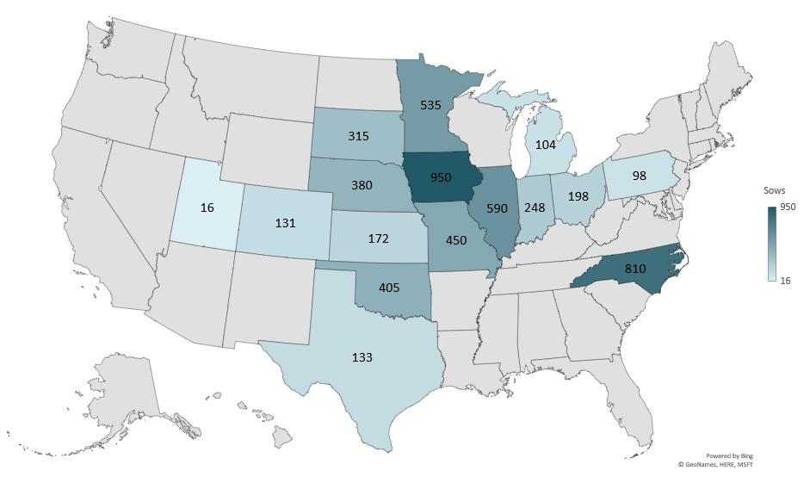
JUNE– NOVEMBER 2024 SOWS FARROWING
(1000 Head)
Livestock Marketing Information Center
Data Source: USDA-NASS

Slide 4
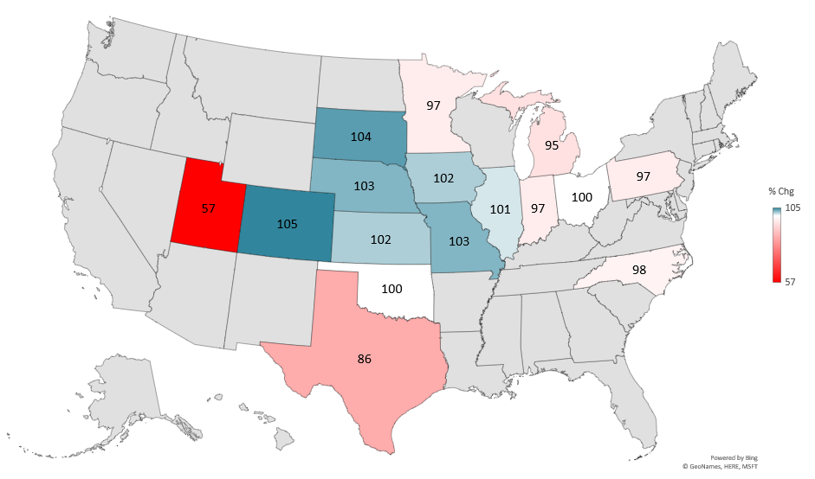
JUNE– NOVEMBER SOWS FARROWING
2024 AS PERCENT OF 2023
Livestock Marketing Information Center
Data Source: USDA-NASS

Slide 5
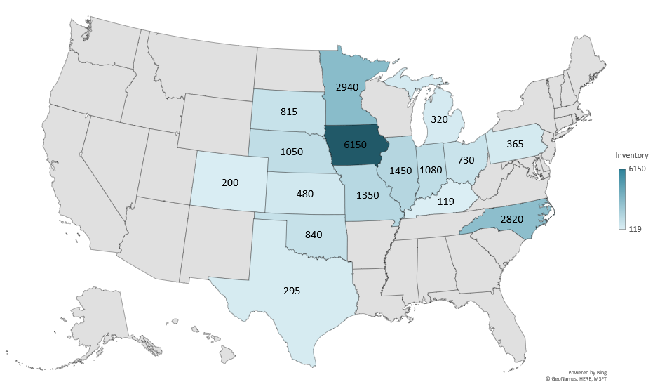
MARKET INVENTORY BY WEIGHT GROUP – UNDER 50 LBS
December 2024 (1000 Head)
Livestock Marketing Information Center
Data Source: USDA-NASS

