Slide 1
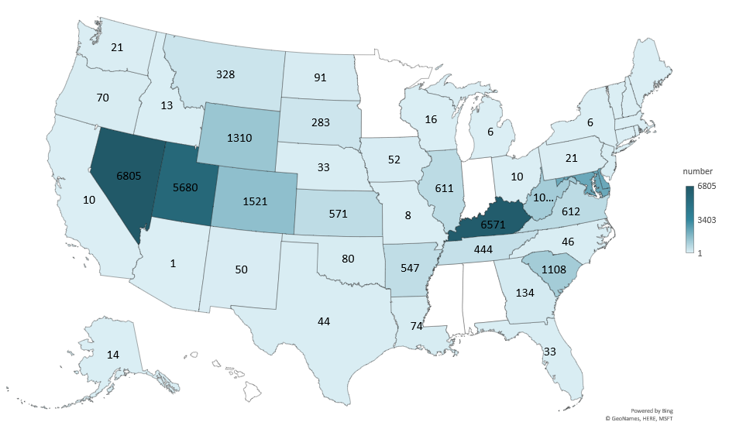
COMMERCIAL CATTLE SLAUGHTER 2023
(1000 Head)
Livestock Marketing Information Center
Data Source: USDA-NASS

Slide 2
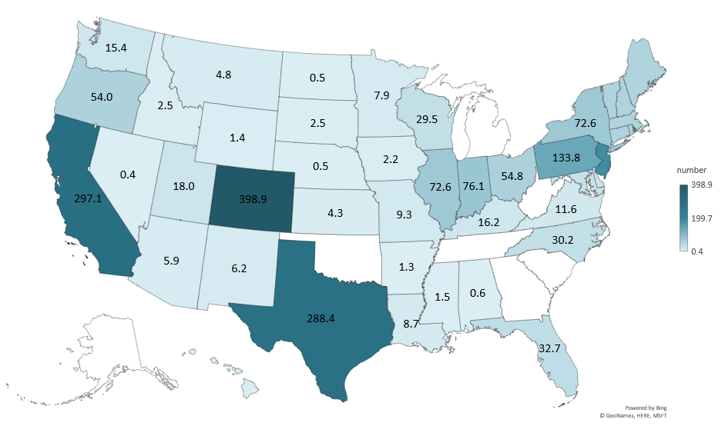
COMMERCIAL SHEEP SLAUGHTER 2023
(1000 Head)
Livestock Marketing Information Center
Data Source: USDA-NASS

Slide 3
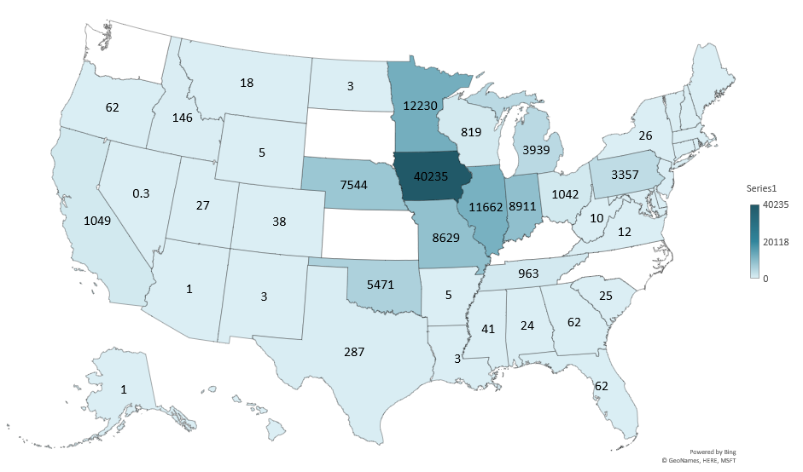
COMMERCIAL HOG SLAUGHTER 2023
(1000 Head)
Livestock Marketing Information Center
Data Source: USDA-NASS

Slide 4
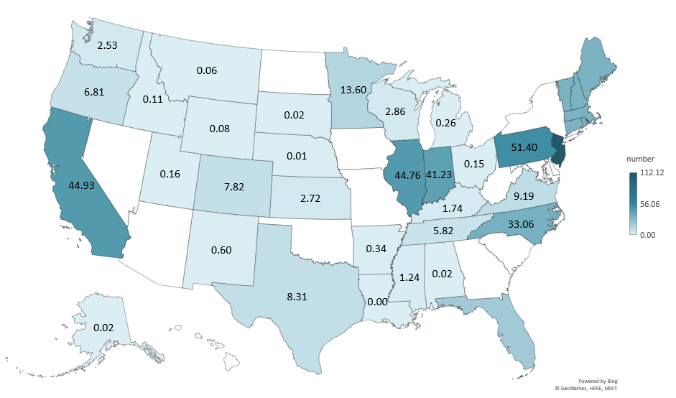
FEDERALLY INSPECTED GOAT SLAUGHTER 2023
(1000 Head)
Livestock Marketing Information Center
Data Source: USDA-NASS

